Slide 1

Shopping Customer Segmentation
Notes:
Line spacing + Page numbers

Slide 2

Segment Shopping Customer
Problem Statement: understand the Target Customer for the marketing team to plan a strategy.
Context: Your boss wants you to identify the most important shopping groups based on income, age, and the mall shopping score.
He wants the ideal number of groups with label for each.

Slide 3
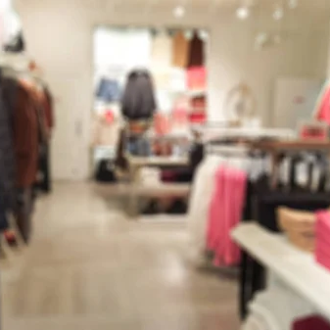
Objective Market Segmentation
Divide your mall target market into approachable groups.
Create subsets of a market based on demographics behavioral criteria to better understand the target for marketing

Slide 4
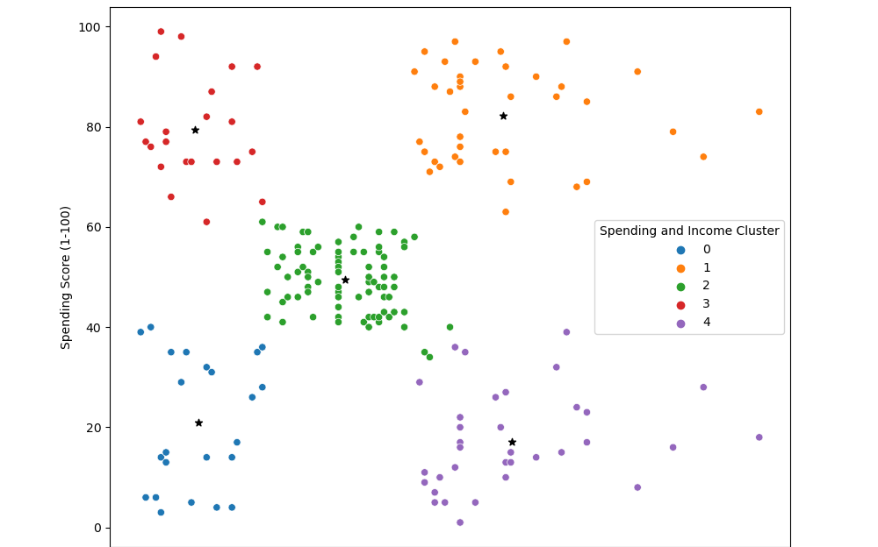
Analysis
Target Cluster
Target group would be cluster 1 which has a high spending score and high income.
54 percent of cluster 1 are women, a market strategy should be generated for this group, targeting popular items in this cluster.
Cluster 3 presents an interesting business opportunity for the company, targeting this sector by selling popular items.

